Slide 1

Central Florida Bus System Database
Isaiah Sarria, Randy Koliha, Damian Cutie, Christopher Aguiar, Simon Pringle

Slide 2

Database Description
This database design of a Central FL bus system handles processes related to:
Bus route scheduling
Drivers
Passengers
Tickets and passes

Slide 3
20 Business Rules
Many passengers can ride on one bus
One bus can only hold many passengers
A route can have many stops
Many stops can be a part of one route
Each passenger can only have one ticket
One ticket is bought by one passenger
One city can have many routes
Many routes may be in one city
Each bus has one route
One route may have many buses
Each passenger can enroll for one account
One user account can only have one passenger associated
One city can have many buses
Many buses can be in one city
Many passengers can only purchase one pass.
A pass can be purchased by many passengers
Many tickets can be bought by one user account
One user account can buy many tickets
One pass can be registered to one user account
One user account can have one pass registered to it

Slide 4
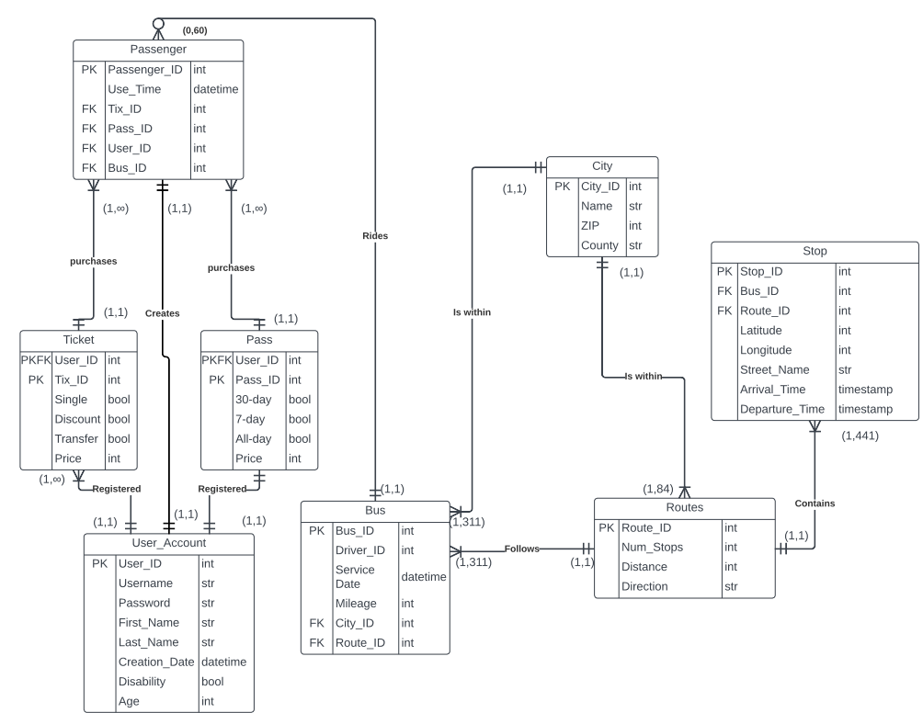
Notes:
Passenger table contains: attributes: passenger_id (primary key), use_time (primary key), tix_id (foreign key), pass_id (foreign key), user_id, bus_id (foreign key). The passenger table contains relationships connecting to it.
-This table shows when and where as well as how passengers have scanned into a bus
Ticket table contains: attributes: user_id (primary key and Foreign key), tix_id (primary key), single,discount, transfer, price. Ticket has relationship 1 to m to passenger.
-This table shows what types of tickets the users bought
Pass table contains: attributes: user_id (primary key and Foreign key), Pass_id (primary key), 30-day, 7-day, all-day, price. passs has relationship 1 to m to passenger.
-This table shows what kind of pass was bought by users
User account table: has attributes: user_id (primary key), username, password, first_name, Last_name, Creation_date, disability, age. User_account has relationships: 1 to m connecting to ticket and pass, 1 to 1 relationship connecting to passenger.
-This table holds information about user accounts in order to then purchase tickets or passes
Bus table: has attributes: bus_id (primary key), driver_id, servicedate, mileage, city_id (foreign key), route_id (foreign key). Bus table as relationships: 1 to m relationship connecting to passenger table.
-This table holds information about the buses location and service
City table: has attributes: city_id (primary key), name, ZIP, county. City has relationships 1 to m connecting to bus and 1 to m connecting to routes.
-This table holds information about where each city is located.
Routes table has attributes: route_ID (primary key), num_stops, distance, direction. With relationship 1 to many connecting to bus.
-This table shows the direction and distance as well as how many stops are in each route
Stops table: attributes: stop_id (primary key), bus_id (foreign key), routes_id (foreign key), latitude, longitude, street_name, arrival_time, departure_time. With relationships 1 to many connecting to routes.
-This shows what buses stop at a stop location and where the stops are located as well as when buses arrive and depart.

Slide 5
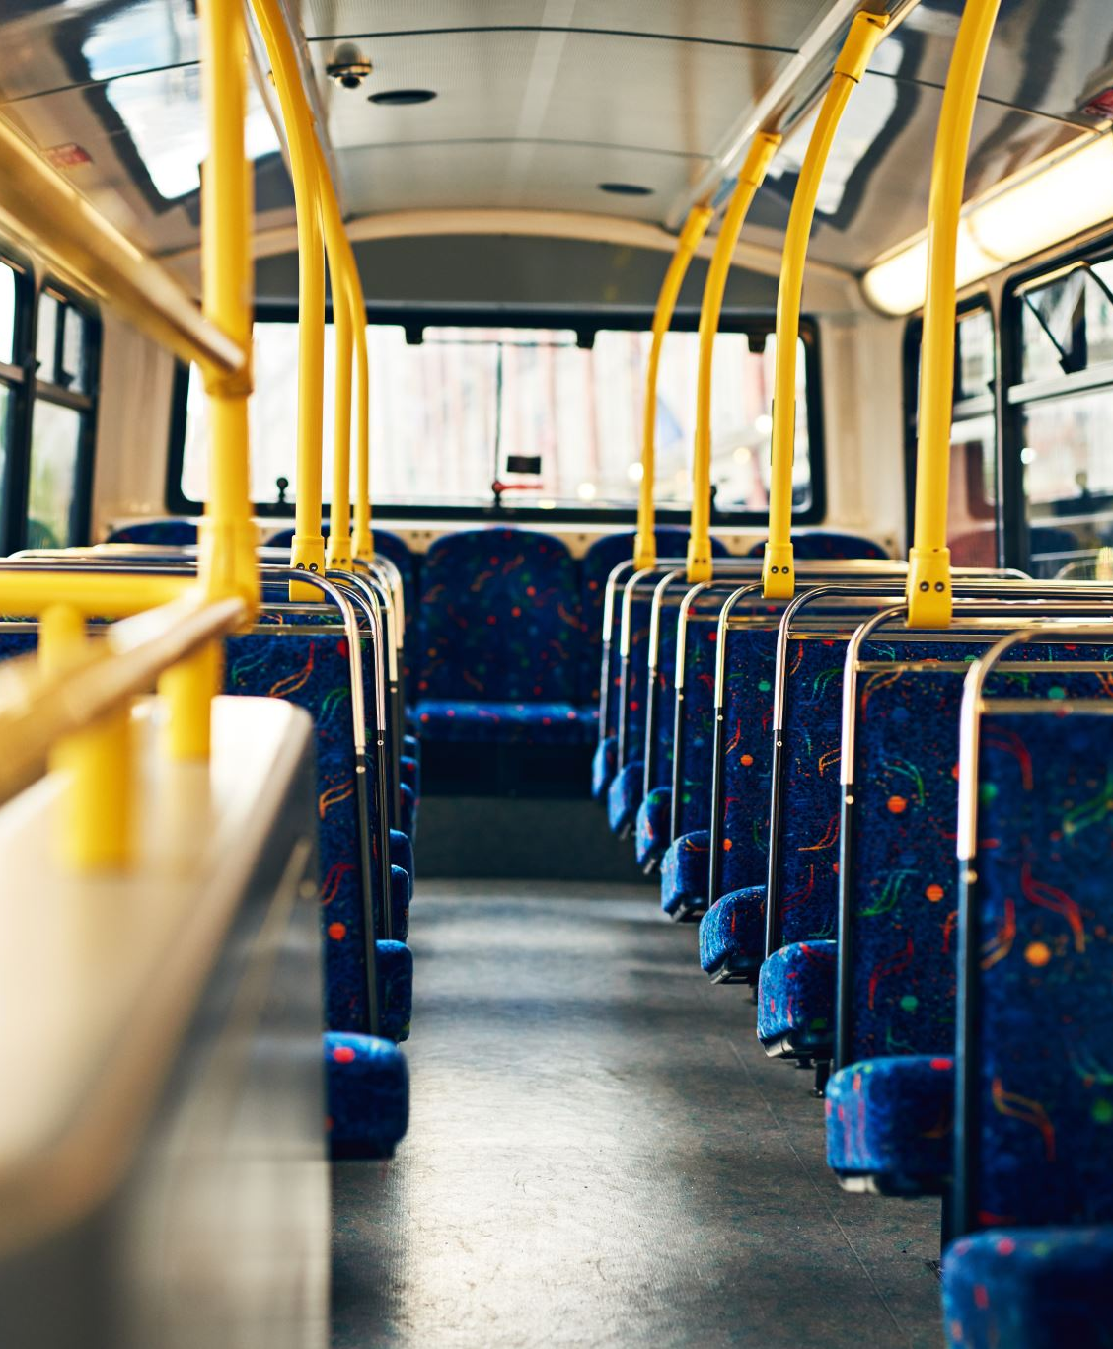
Interesting Queries
How many users sign up each month?
How many disabled passengers have ridden each bus?
How many buses are in each city?
How many passengers does the route with the most stops have?
What is the total count of buses with passengers and the total number of passengers on those buses in each city?

Slide 6
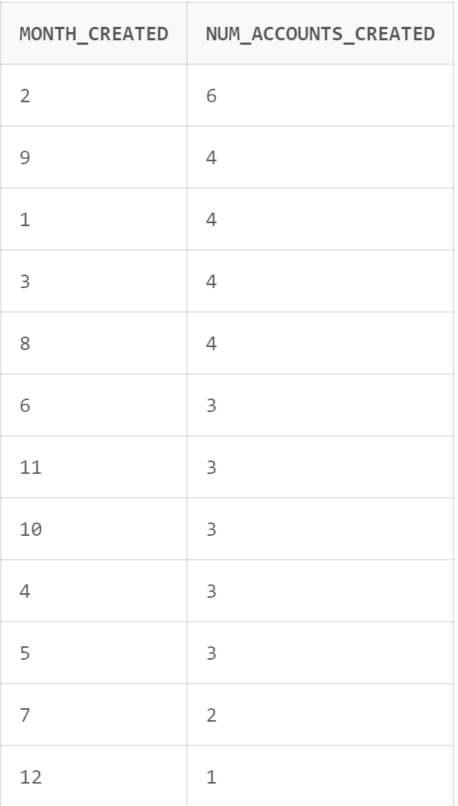
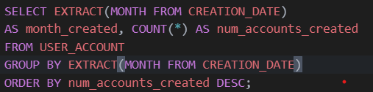
How many users sign up each month?
Could be useful to identify seasonality trends in bus usage
This code extracts the month from the CREATION_DATE attribute then saves it into Month_Created. It then extracts the number of accounts created in those months and sorts them by descending order.

Slide 7
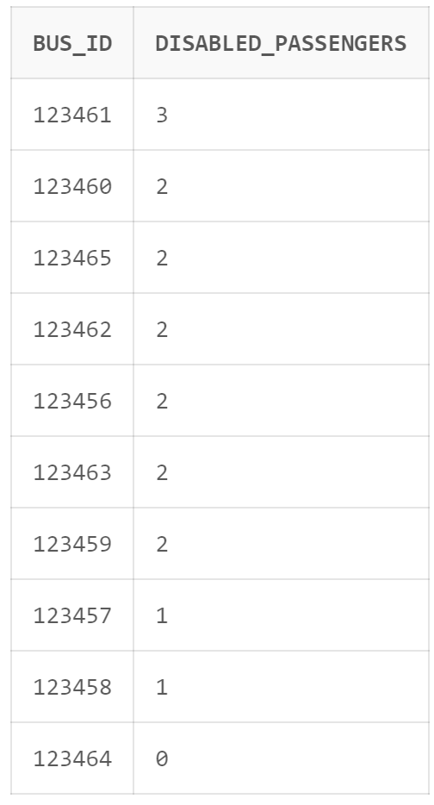
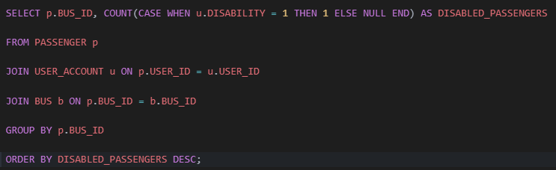
How many disabled passengers have ridden each bus?
Could be used to estimate which routes are popular among disabled passengers to better accommodate them
This code selects the Passengers Bus ID's and counts them if the passenger is disabled. It then joins the tables and displays all the busses that have disabled passengers that have ridden on them.

Slide 8
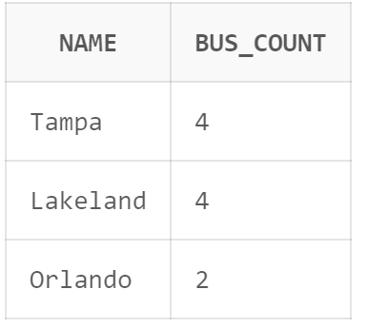
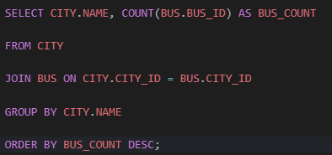
How many buses are in each city?
Could be used to estimate costs associated with buses in each city such as labor, gas, bus purchases, etc.
This code selects the name of cities and counts how many unique busses are assigned to that city. The code then joins the tables and groups them by city name. The code then displays cities and how many busses belong to them.

Slide 9
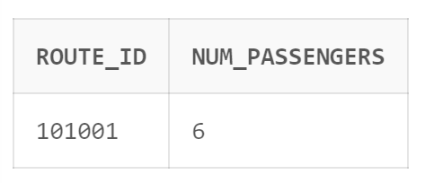
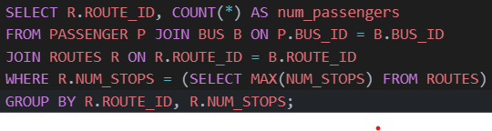
How many passengers does the route with the most stops have?
Discovering how many disabled passengers have ridden each bus, could be used to better accommodate to passengers for this specific route
The code counts the number of passengers and saves them under the alias num_passengers. The tables are then joined and the next selection is made for the maximum amount of stops from the routes table then displays the passenger count.

Slide 10
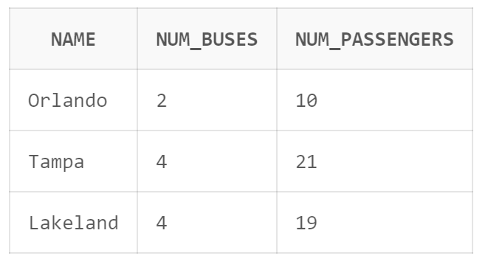
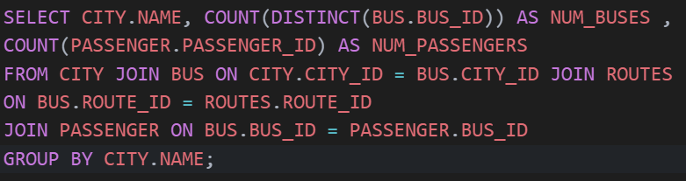
What is the total count of buses with passengers and the total number of passengers on those buses in each city?
The shown query will help with determining the use of our busses and whether we can expand or not, whether that be the number of buses or the capacity of our buses.
The number of distinct Bus IDs is saved under the num_buses alias and then counts the total number of passengers among those buses per city. These were selected from four joined tables where the City_ID is matched with the Bus and City table then linked where the Bus_ID match with the Bus and Passenger table which is then finally grouped by city name.

Slide 11
Thank You!

